Slide 1


PROJECT B.A.T.
A Google Earth Pro To Minecraft
Blueprint Automation Tool
Kevin Green
B.S. Computer Science
1

Slide 2

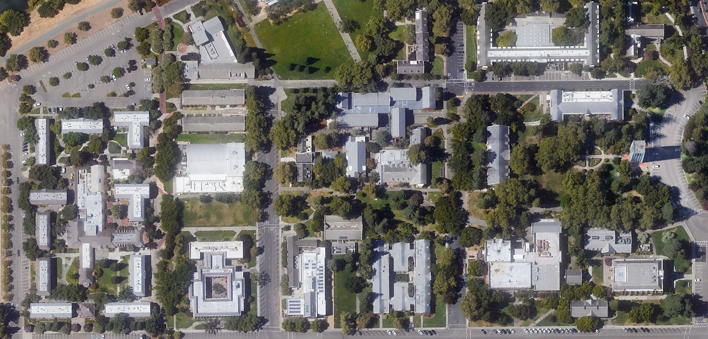
BACKGROUND
Building Real-Life Places
Item 1
Project B.A.T.
2

Slide 3

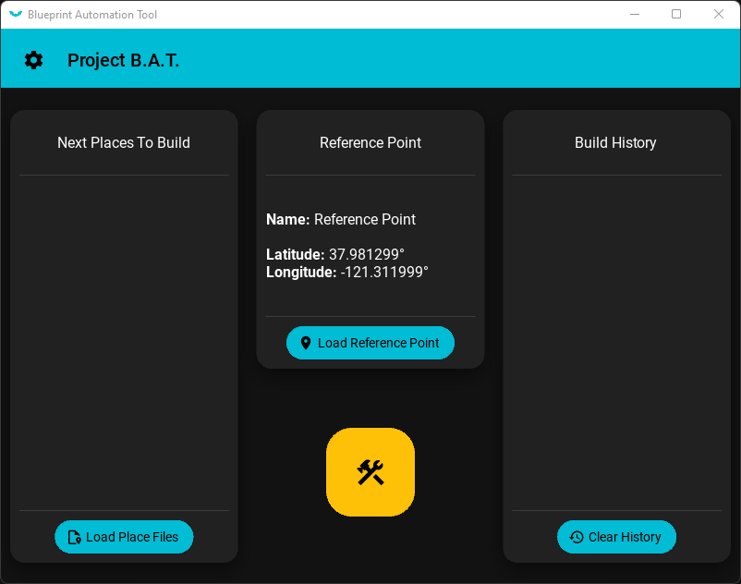



IMPLEMENTATION
Game Automation
Basic Idea of Game Automation
Settings
Basic Idea of Settings
User Interface
Basic Idea of User Interface
Project B.A.T.
3

Slide 4

CONCLUSION
Summary
Summary of Background
Summary of Implementation
Major Features
Game Automation
User Settings
Material Design Interface
What To Expect
Item 1
Item 2
Item 3
Project B.A.T.
4

Slide 5
PROJECT B.A.T.
Thank You!
5

